Slide 1

Pool Club Management Software
AIT 725 Software Engineering Case Study
By Evan Lyle
Notes:
Hello, my name is Evan Lyle. Today, I will be presenting the process and results of my case study for AIT 725 Software Engineering. The project for my case study was the development of a pool club management software.

Slide 2

Table of Contents
Introduction
Technologies Used
Entity Relationship Diagram (ERD)
Wireframes
Use Case Diagram
Pool Manager
Pool Operator/Lifeguard
Lifeguard
Employee
System Layout
Software Demonstration
Challenges
Time Constraints for Unimplemented Features
What I Wish I Knew at the Beginning of the Project
Future Plans for the Pool Club Management Software
Conclusion
Acknowledgements
Notes:
These are the points I shall be talking about throughout the presentation.

Slide 3



Introduction
Problems
Solution
Pool clubs in the USA are mismanaged
Problems with budget and resources
Create database management software to keep track of the various resources:
Chemical readings
Chemicals in stock
Staff members
Maintenance tasks
Scheduling
Notes:
Did you know that most pool clubs in the United States of America are mismanaged? That they have problems with budget and resources? If you did not, then you do now.
Luckily, there is a solution: I have created a database management system designed to track the various resources such as chemical readings, the amount of chemicals in stock, staff members, maintenance tasks, and schedule tracking.

Slide 4
Technologies Used
dia: Entity Relationship Diagram (ERD)
Balsamiq: Developing wireframes
Python: Programming language
Python tkinter: Graphical User Interface (GUI)
MySQL: Database storage and language
MySQL-Python Connector Allows Python and MySQL to pass data back and forth
GitHub: Used for versioning/storage
Microsoft Word: Writing documents
Adobe PDF files: Submission and water quality regulation report outputs
Microsoft VS Code: Writing the Python code
Notes:
Here is a list of technologies that were used throughout the project. For example, dia (which is intentionally lowercase) is the program used to construct the Entity Relationship Diagrams (aka ERDs). Balsamiq was used to develop the wireframes in order to get an idea for what the vision of the project and its interface would look like. The database itself is stored in MySQL. The languages used for this project included Python and SQL syntax, both of which worked with the MySQL-Python Connector in order to allow Python and the MySQL database to pass data between each other. Python tkinter was utilized for realizing the graphical user interface (GUI). GitHub was utilized as the repository to keep track of different versions of the system. Microsoft Word was used for writing the appropriate documents. The project proposal, the final iteration of the final report, and the output of the Water Quality Regulation Reports are in the format of Adobe PDF files. Last but not least, the Python code and Python tkinter code were written in the Microsoft Visual Studio Code interface development environment.

Slide 5
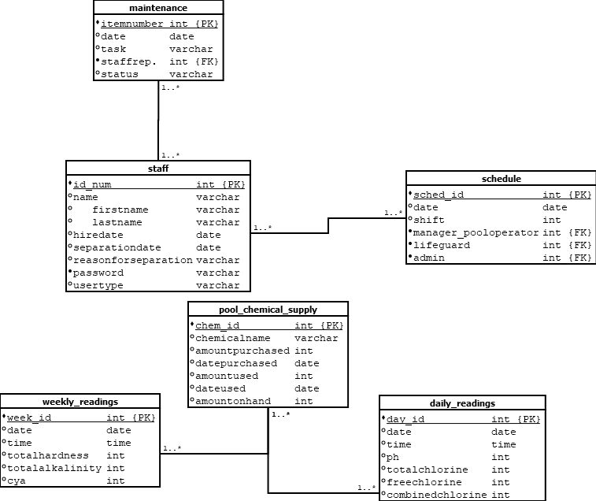
Entity Relationship Diagram
Notes:
This is the Entity Relationship Diagram for the system. It is meant to show how each entity/table of the system is meant to connect to each other. The ERD was developed during the planning phase of my project. After researching what is required to manage a community pool, I developed a requirements document for the software. Then, this ERD was developed to manage all of the data that was going to be required.

Slide 6
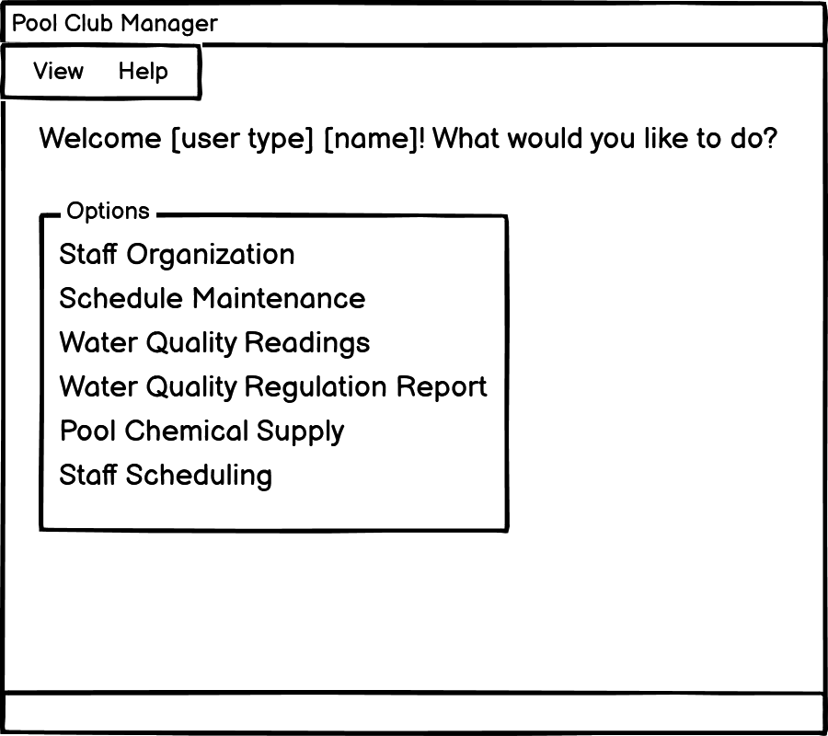
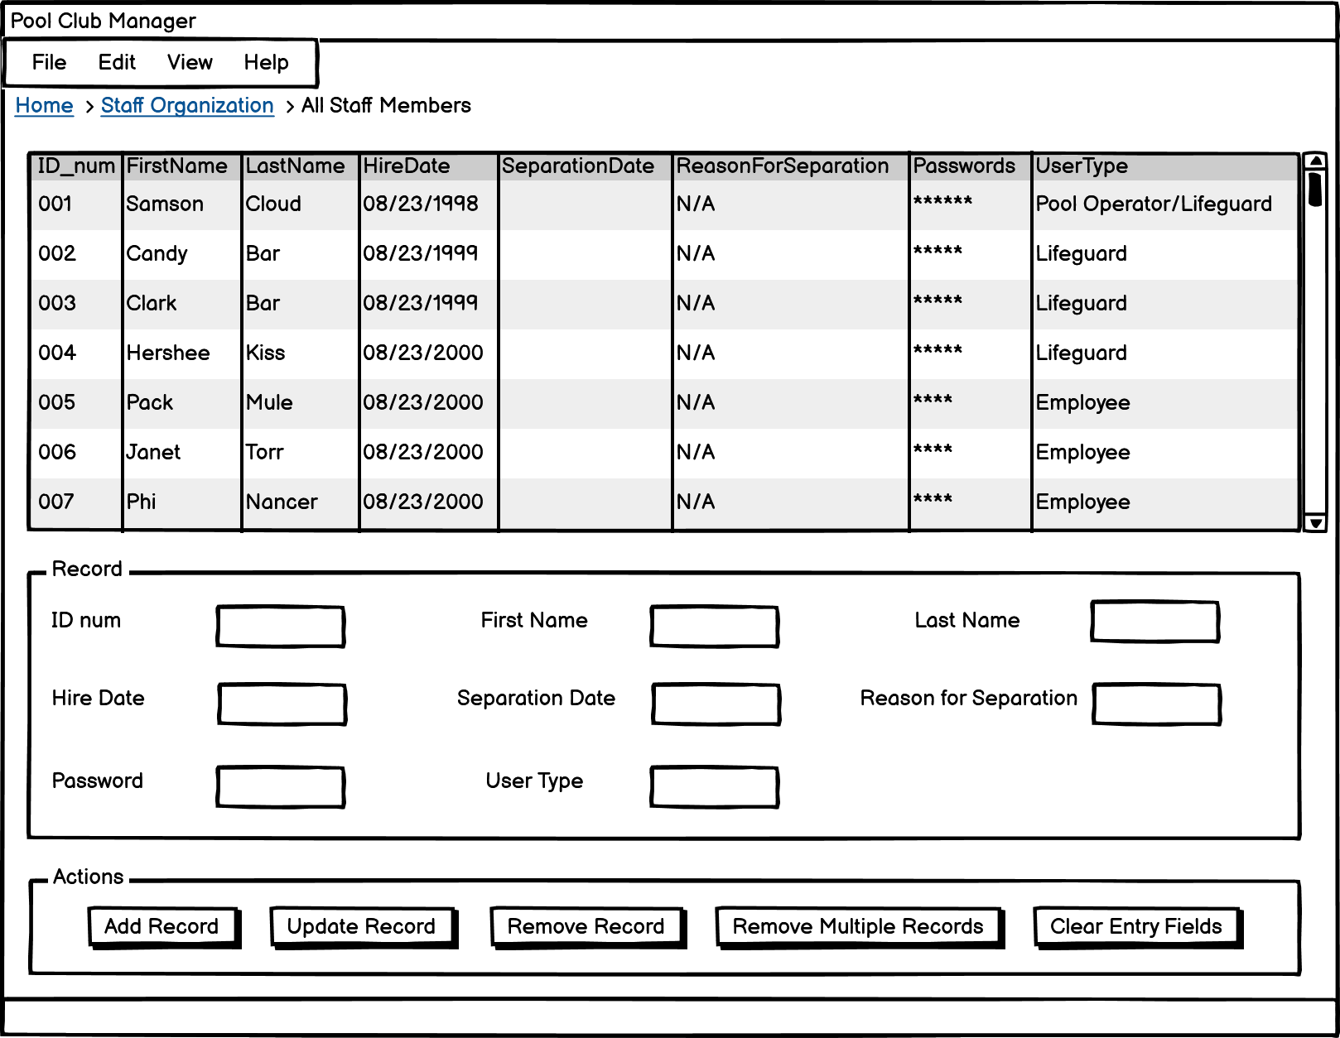
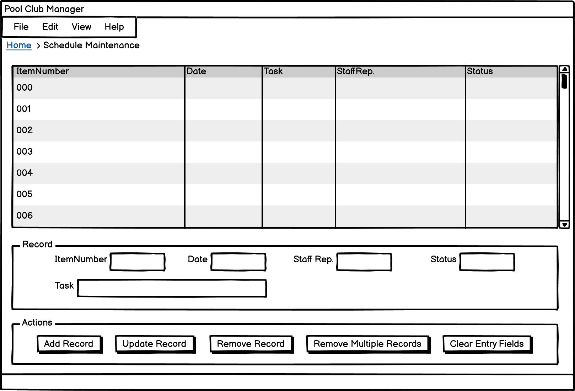
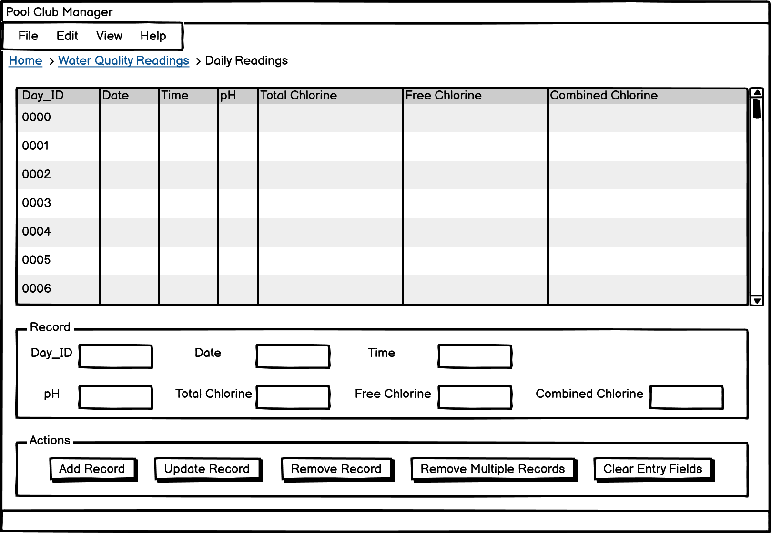
Wireframes
Made multiple wireframe mock-ups for different screens
Reflects the original vision for the system in GUI form
Notes:
Here are some examples of the different wireframes I have created. These were developed using the Balsamiq software and reflect the original vision for the system in GUI form, so some things changed during development.

Slide 7
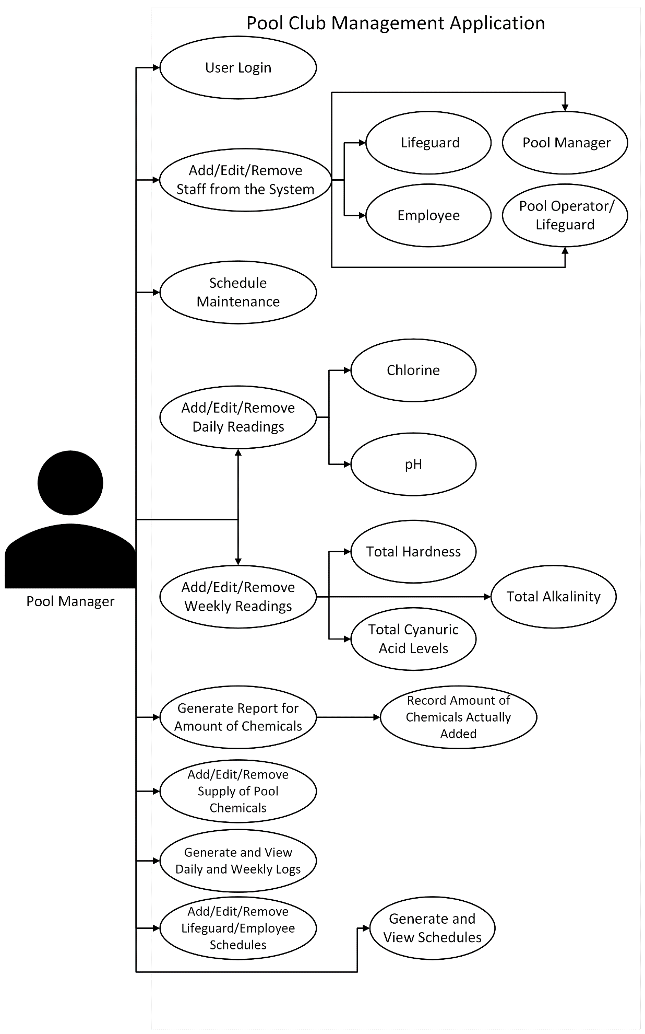
Use Case Diagram – Pool Manager
Notes:
The software is meant to manage the different resources for hosting a pool club. To that end, it allows users to store and retrieve various pieces of data from staff lists, management tasks, staff schedules, both daily and weekly readings, and the pool chemical supply from the different tables in the database.
The way the system was designed to function during the planning phase varies depending on the User Type, which is shown through four different use case diagrams. This is the use case diagram for the Pool Manager user, showing that they have access to the full functionality of the application.

Slide 8
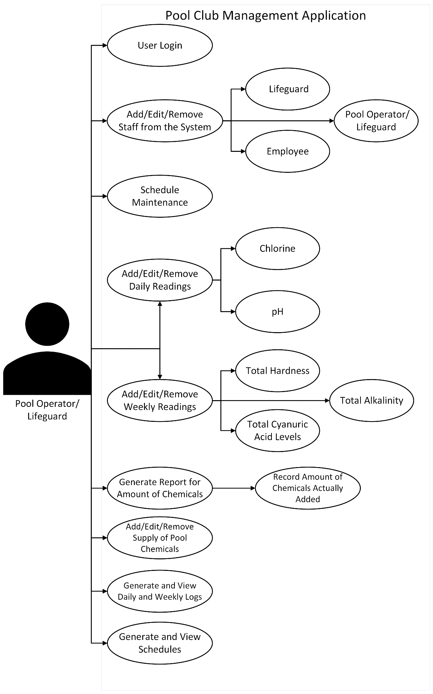
Use Case Diagram – Pool Operator/Lifeguard
Notes:
This is the use case diagram for the Pool Operator/Lifeguard user, showing that they have access to most functions in the application.

Slide 9
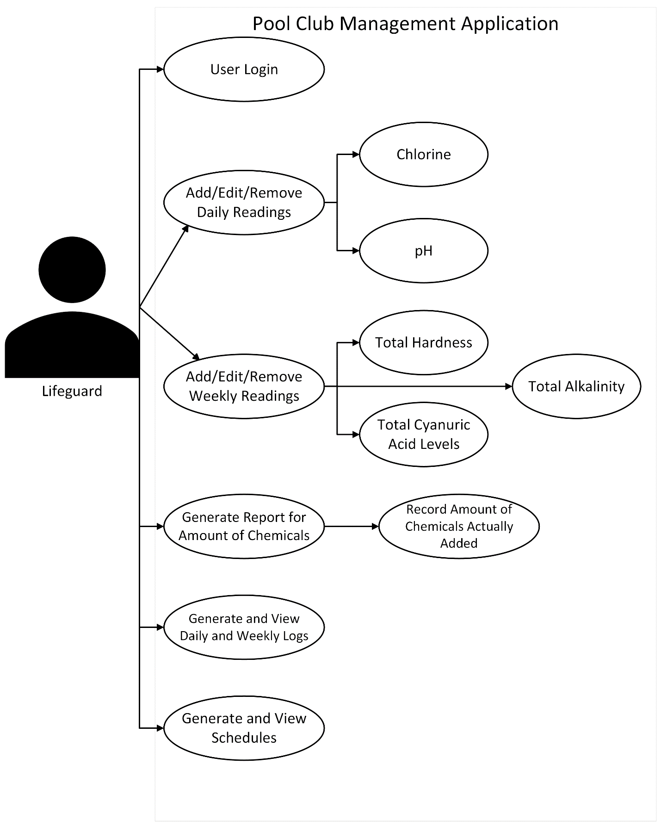
Use Case Diagram – Lifeguard
Notes:
This is the use case diagram for the Lifeguard users, showing that they have access to a moderate number of functions. They can view their schedules; can report on the chemicals; have the ability to add, edit, or remove both daily readings and weekly readings; and have the ability to generate and view water quality logs and water quality regulation reports.

Slide 10
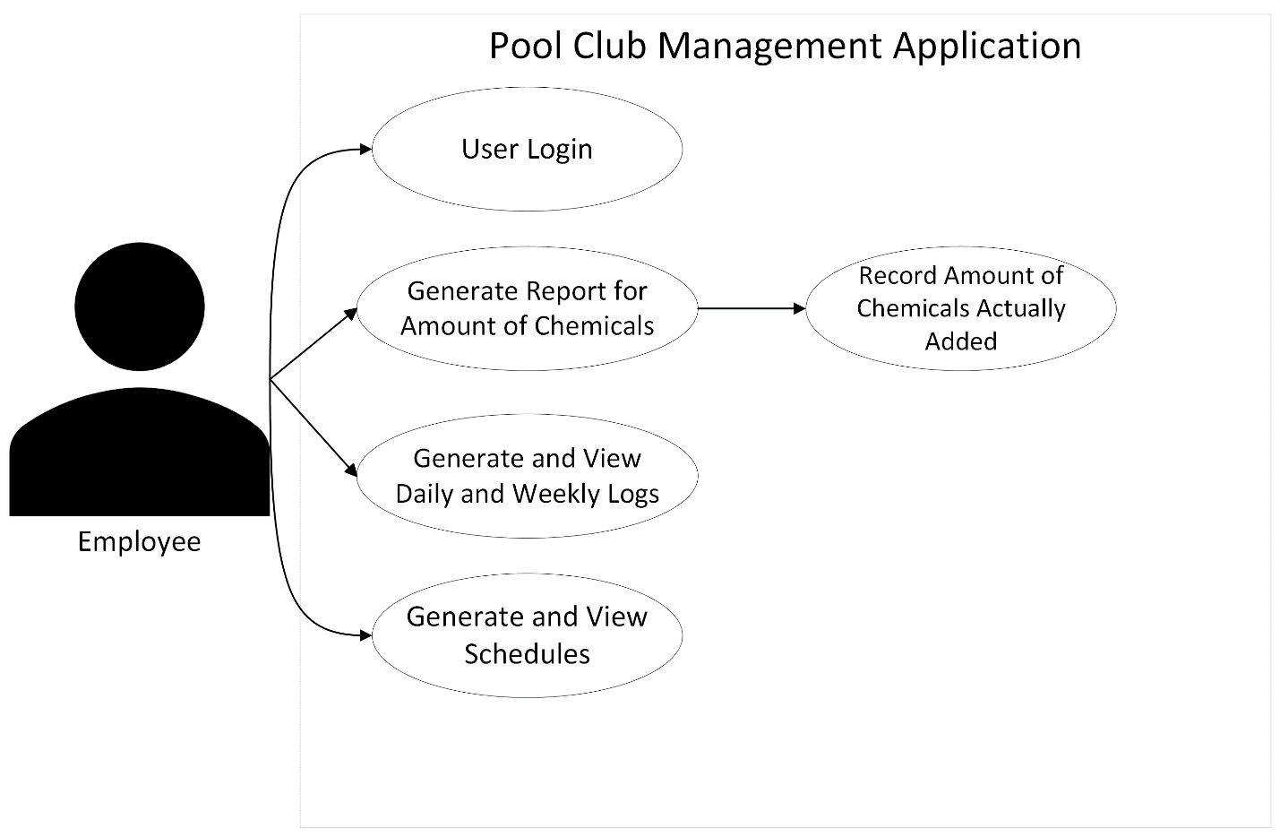
Use Case Diagram – Employee
Notes:
This is the use case diagram for general purpose Employees, which only have a limited number of permissions on the system.

Slide 11
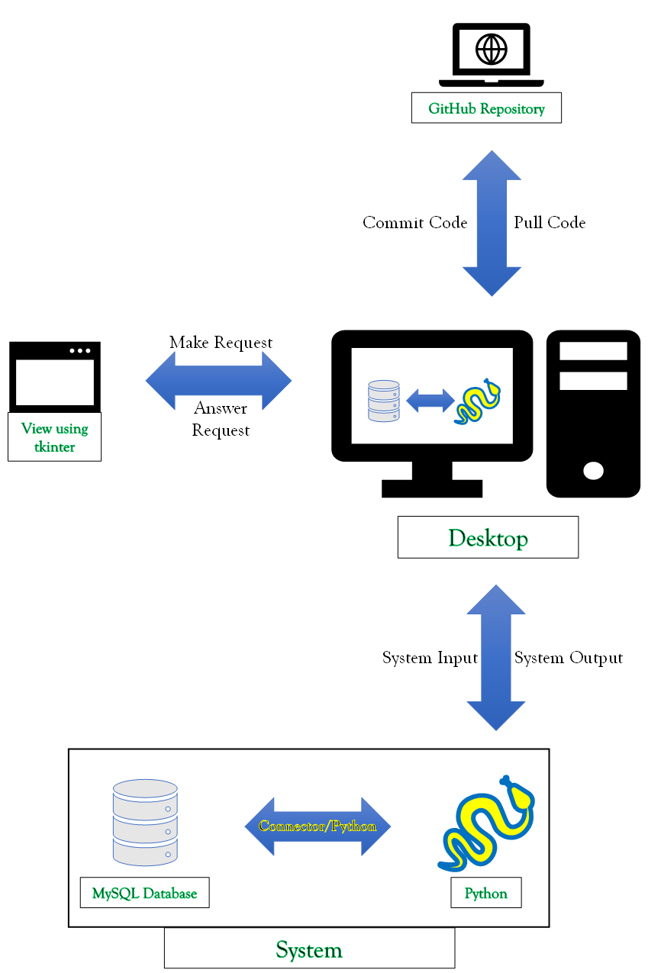
System Layout
Software made for desktop
Desktop stores all the following:
Graphical User Interface (GUI) files
Application Programming Interfaces (API files)
MySQL database
Python used for coding APIs
Python tkinter used for constructing GUIs
Notes:
The layout of the system is shown before you. The software was designed with a desktop in mind when it comes to hardware. As such, the desktop contains the GUI files, the API files, and the MySQL database. The APIs are coded with Python, while Python tkinter was used for the GUI.

Slide 12

Software Demonstration
Notes:
After all of this planning, I developed the software by first creating the APIs using Python and a database constructed using MySQL in accordance with the ERD previously shown. I then developed the GUIs with tkinter and tied them back into the APIs.
Now, it is time to demonstrate the software.
>run program
Here is the home screen. I’ll start by demonstrating the daily readings interface.
>open Daily Readings screen
See that list near the top? That’s the treeview that displays all of the data for the appropriate table in the database.
First, I’ll insert a record by typing in the entry fields under the Record section, followed by clicking the Add Record button.
>insert ‘7 | 2023-12-14 | 11:00:00 | 7.0 | 3.5 | 3.5’
>click Add Record
The new record now shows up in the treeview. After entering in a date, click the Generate Water Quality Regulation Report button to generate such a report for your daily readings.
>enter ‘2023-12-14’ into Date field
>click Generate Water Quality Regulation Report
A popup lets you know the report has been created.
>close popup
Now, if you want to free up the fields, click the Clear Fields button.
>clear fields
>close Daily Reading screen
Next, I shall demonstrate the weekly readings interface.
>open Weekly Readings screen
Like the last screen, I shall enter in a new record through typing in the entry fields, then clicking the Add Record button.
>insert ‘7 | 2023-12-18 | 17:00:00 | 174 | 55 | 65’
>click Add Record
There is also a button to generate a water quality regulation report for the weekly readings. It shares the same button name as well.
>click Generate Water Quality Regulation Report
There is also a popup letting you know the report was successfully created.
>close popup
>close Weekly Readings screen
>clear fields
>show daily report
This is the daily report. It shows the date, time, and various chemical readings.
Unfortunately, the daily report should contain statements about the water quality. It also should identify the amount of chemicals that need to be added. However, the API called chemical_evaluation.py was accidentally overlooked and does not properly connect to the rest of the APIs.
>show weekly report
This is the weekly report. It shows the date, time, and various chemical readings.
I still have the appropriate calculations that can still connect to the database independently to the rest of the program, so I shall quickly show it to you.
>run chemical_evaluation.py
>show console
As you can see, this module generates results of comparing the most recent chemical readings with the Maryland standards. In this example, the pH is too low, and the console reflects what action should be taken to correct this problem. This also functions with the other chemical readings.
>back to GUI Interface
As for the other screens, they share functionality with the other reports. Allow me to briefly show them.
>open Staff Organization screen
This is the Staff Organization screen.
>close Staff Organization screen
>open Schedule Maintenance screen
This is the Schedule Maintenance screen.
>close Schedule Maintenance screen
>open Pool Chemical Supply screen
This is the Pool Chemical Supply screen.
>close Pool Chemical Supply screen
>open Staff Scheduling screen
This is the Staff Scheduling screen, the last screen in the program.
>close Staff Scheduling screen
>close program
>return to presentation
Details on how to use the software have been documented in the user manual.

Slide 13
Challenges
Learning how to use Python programming language and Python tkinter
Was self imposed; previously had limited Python experience and no Python tkinter experience
Chosen because Python is currently in demand for the job market
A programming limitation of Python; could not display preview of PDF document before download
Time constraints; in hindsight, originally planned scrapped features would have needed more time than allotted in a semester
Notes:
I have faced a lot of challenges when trying to complete this project. One of them was actually self-imposed: learning Python. I have not had much prior experience with the Python programming language, let alone Python tkinter. Despite this, I chose to use Python as the programming language due to it being in high demand.
In terms of programming limitations, one of them was the fact that there was no way for the program to display a preview of a PDF file downloading it. Thus, I had to scrap the initial wireframe concept and settle for relegating the generation of the Water Quality Regulation Reports to a simple button press.
There were also a couple of challenges related to time constraints in terms of the features I was able to add to the program. In hindsight though, the features that I had initially planned needed more time to implement than in the span of a semester.

Slide 14
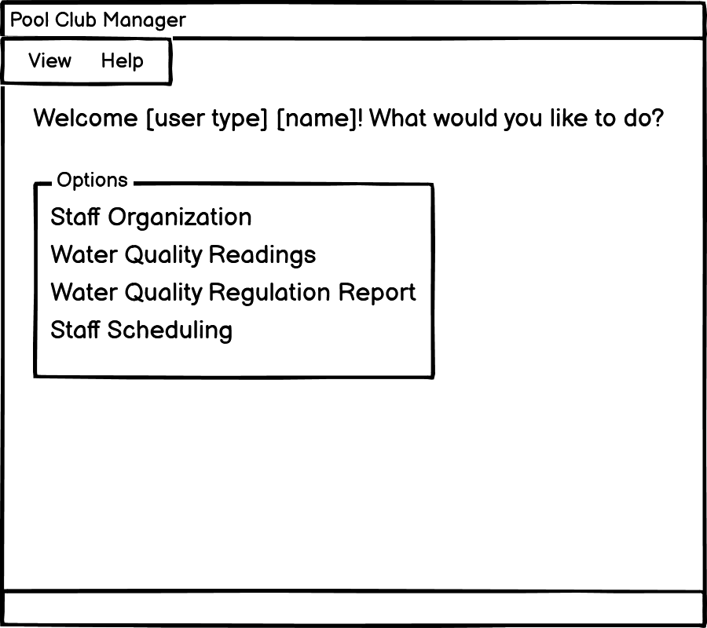
Challenges – Time Constraints for Unimplemented Features
Login screen and user permissions
Saved for last in order to get the main program to function
Would have involved multiple views and user capabilities depending on the type of user account
Sorting and filtering which records are displayed in treeview based on specific fields; was supposed to make finding certain records easier
Home Screen for Pool Manager & Pool Operator/Lifeguard user logins
Home Screen for Lifeguard & Employee user logins
Notes:
Among these scrapped features was the login screen and the different screens based on user permissions by extension. It was saved for last due to the fact that I needed to make sure all of the other features were able to function. It basically amounted to the fact that an account’s user type would have limited the amount of functionality one could have with the software. An example of this is shown on the right.
Another feature which I ran out of time to implement the ability to sort the treeview of a table from the database by specific fields. It would have made searching for specific records easier on the user.

Slide 15
What I Wish I Knew at the Beginning of the Project
How APIs interact with user interfaces
Previous coding experience involved most (if not all) code in program contained in one file; have not worked with APIs before.
Ended up having to rewrite APIs due to lack of knowledge on them
A simpler method of passing variables from GUI entry fields into an SQL statement
Had written SQL statement for buttons to pass in all of the fields into the function at once, regardless of whether they were blank, meaning everything could potentially be overwritten when pressing an “Update Record” button
Might be possible to do in the future after the semester has concluded
Notes:
There are a couple of factors that I really wish I was aware of before starting this project. The first of these being how APIs interact with user interfaces. Most of my programming experiences have been focused on most of (if not all) the code being present in a single file, so I have not worked with APIs before this semester. It caused me to have to rewrite my API files in order for it to be compatible with the GUI files.
I also wish I knew a simpler method of passing variables from the GUI entry fields to an SQL statement. The reason for this is the way I wrote the functions: I basically had the program pass in all of the entry fields at once, so it can be easy to overwrite a variable of the record when clicking the Update Record button. I want to look into this after the semester has concluded.

Slide 16
Future Plans for the Pool Club Management Software
Login screen: Will contain username, password, and two-factor authentication
Different account permissions
Screens and permissions will be different depending on the account’s User Type
User Types are…
Pool Manager
Pool Operator/Lifeguard
Lifeguard
Employee
Expand functionality to match that of states outside of Maryland
Notes:
Speaking of, here are my future plans for the pool club management software.
First of all, I need to implement the login screen. It will not only contain username and password fields but shall also involve two-factor authentication. Afterwords, I will be able to implement the different screens and account permissions. As previously shown, the different user types consist of Pool Manager, Pool Operator/Lifeguard, Lifeguard, and Employee. Last but not least, I will focus on the program being able to respond according to the standards of states outside of Maryland (as the parameters were actually based on the state government).

Slide 17

Conclusion
First major solo project
Involved all of my skills learned from AIT courses
What I learned:
New software: Balsamiq and Python tkinter
Expanded knowledge of Python and MySQL
Learned how to successfully connect a Python program to a MySQL database and get them to work together through the use of SQL statements and Python variables
I am proud of what I have accomplished despite not all of my planned features making it in the final product.
Notes:
This was my first major solo project in which all of my knowledge and skills gained from my AIT courses were poured into. It was a fulfilling project which allowed me to learn new software and expand my knowledge of Python and MySQL. I was exposed to the Balsamiq wireframe software (which I have decided to keep for future projects) and how to use the Python tkinter GUI. I also learned how to connect a Python program to a MySQL database and have them work together.
Even though not everything I planned ended up in the final product, I am still proud of what I have accomplished in the time frame of this semester and plan to turn this GUI into a monetizable product.

Slide 18
Acknowledgements
My advisor, Prof. Jal Irani for being patient and helping when he can; even going as far as to learn some Python to help
AIT Department for all the courses they had taught
AIT Program Director Cheryl Brown for approving my proposal for this case study
LinkedIn Learning: Tutorials on Python tkinter
The freeCodeCamp.org website for providing information on Python’s version of case-switch (which helped with the pre-GUI version of the APIs)
My family—mother and father—for keeping me on track instead of spinning my wheels
Notes:
I would like to thank my advisor, Professor Jal Irani for his patience and assistance, even going the extra mile to learn a little bit of Python.
I am thankful to the AIT Department for everything they taught me, and to AIT Program Director Cheryl Brown for approving my case study proposal.
I would like to thank the LinkedIn Learning service for providing tutorials on Python tkinter, and the freeCodeCamp.org website for their information on Python’s version of case-switch statements.
Finally, I would like to thank my family (my mother and father) for making sure I stayed focused and did not get stuck on one aspect of my project for too long.

Slide 19

References
[1] GitHub, “Let’s build from here,” GitHub, [Online], https://github.com/ (accessed Jun. 27, 2023).
[2] L. Barbosa and A. Hora, “How and Why Developers Migrate Python Tests,” in 2022 IEEE International Conference on Software Analysis, evolution and reengineering (saner), 2022, pp. 538–548
[3] MySQL.com, “MySQL Connector/Python Developer Guide,” MySQL, [Online], https://dev.mysql.com/doc/connector-python/en/ (accessed Jun. 28, 2023).
[4] Python Software Foundation, “Python 3.11.4 documentation,” 3.11.4 Documentation, [Online], https://docs.python.org/3/ (accessed Jun. 28, 2023).
[5] Python Software Foundation, “tkinter - Python interface to TCL/TK,” Python documentation, [Online], https://docs.python.org/3/library/tkinter.html (accessed Jun. 28, 2023).
[6] Python Software Foundation, “unittest — Unit testing framework,” Python documentation, [Online], https://docs.python.org/3/library/unittest.html (accessed Jun. 27, 2023).
[7] M. Reichardt, M. Gundall, and H. D. Schotten, “Benchmarking the Operation Times of NoSQL and MySQL Databases for Python Clients,” in IECON 2021 - 47th annual conference of the IEEE industrial electronics society, 2021
[8] B. A. Meier, Python Gui Programming Cookbook: Develop Beautiful and Powerfurl Guis Using the Python Programming Language, Second. Birmingham, UK: Packt Publishing, 2017.
[9] Chris, K. (2023, March 28). Python switch statement – switch case example. freeCodeCamp.org. https://www.freecodecamp.org/news/python-switch-statement-switch-case-example/ (accessed Oct. 15, 2023)
[10] Stone, B. (2018). Create a GUI for your Python desktop application - Python GUI Development with Tkinter Video Tutorial: LinkedIn Learning, formerly Lynda.com. LinkedIn. LinkedIn Learning. Retrieved August 8, 2023, from https://www.linkedin.com/learning/python-gui-development-with-tkinter-2/create-a-gui-for-your-python-desktop-application?u=56674649.
Notes:
These are my references. Please take a moment to look at them.

Slide 20
Thank You
Notes:
Thank you for listening to my presentation. Do you have any questions?

